Slide 1

Database Testing

Slide 2
What is meant by Database testing
Database testing checks the integrity and consistency of data by verifying the schema, tables, triggers, etc., of the application’s database that is being tested. In Database testing, we create complex queries to perform the load or stress test on the database and verify the database’s responsiveness.
An issue in the database might cause a crash or leakage of data, we are aware of the importance of keeping the privacy of the user’s data. So, it is crucial to perform database testing to ensure data integrity, consistency, etc., are being maintained.
Database:
A database is a prearranged collection of data containing the information and helps in data manipulation. A database can easily manage and retrieved by the user. We can establish data into tables, rows, columns, and indexes, making it easier to identify the appropriate data.
In a Database, data management becomes a very easy task because we can use the databases as databases to retrieve the information like tables for storing data, function, triggers for data manipulation and view for data representations.

Slide 3
Benefits of Database Testing
Database testing helps in ensuring the database’s efficiency, stability, performance, and security.
During database testing, we can understand the behavior of complex transactions and how the system handles such queries.
It makes sure that only valid data values and information are received and stored in the database.
Database testing protects us from vulnerabilities like data loss, saves aborted transaction data, and doesn’t allow access to information for unauthorized users.

Slide 4
Objective of the Database Testing:
Ensure Data Mapping: It checks whether the fields in the user interface or front end forms are mapped consistently with the corresponding fields in the database table.
Ensure ACID Properties of Transactions: Every transaction a database performs has to stick to these four properties: Atomicity, Consistency, Isolation and Durability.
Ensure Data Integrity: The updated and the most recent values of shared data should appear on all the forms and screens. The value should not be updated on one screen and display an older value on another one. The status should also be updated simultaneously.
Ensure the Accuracy of the Business Rules: Complex databases leads to complicated components like relational constraints, triggers and stored procedures. Hence in order testers come up with appropriate SQL queries to validate the complex objects.

Slide 5
Database Testing Attributes:
Transactions: Transactions means the access and retrieve of the data. Hence in order during the transaction processes the ACID properties should be followed.
Database Schema: It is the design or the structure about the organization of the data in the database.
Triggers: When a certain event occurs in a certain table, a trigger is auto-instructed to be executed.
Procedures: It is the collection of the statements or functions governing the transactions in the database.

Slide 6
Why Is Database Testing Important?
Without a fully-functioning database, an application cannot be put to proper use. The database is where all information is stored, and it acts as a critical back-end point of any software. Applications rely on a fully-functioning database to store and create information, as well as respond to queries.
The key focus of database testing is to make sure that the values and information stored in the database are accurate.
When undertaking a database test, the tester needs to have a complete understanding of the application. They must then list all possible queries relevant to the software. The development team can also contribute to this. The database test will then help to see if each query works as it should with regards to its specifications.
Without proper database testing, an application may have hidden faults. When using the software, this could mean that data is lost, not created, or incorrectly stored. This could have a major effect on the overall experience and effectiveness of the application.
Database testing also helps to ease the complexity of calls to the backend. It also works to make sure that no harmful or incorrect data is being stored at the backend of the application.

Slide 7
What should be tested?
As this is a form of backend testing, database testing involves aspects of the software which are not visible to the user. This includes the flow of information through the app to the database. This includes data mapping and data integrity.
The ACID properties validation is also included. These are atomicity, consistency, isolation, and durability. Accurate testing of these happens during the DB testing activity. Database testing also needs to cover the accuracy of implemented business rules, as databases are not just for records storage.
All of these different areas of the database and information storage and queries need to be properly tested.

Slide 8
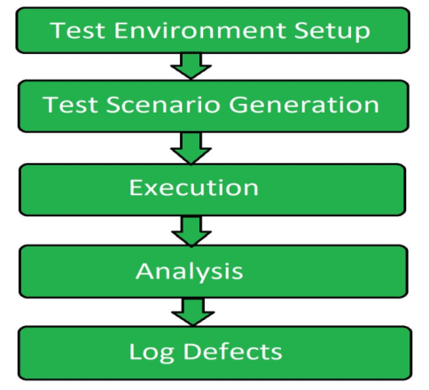
Database Testing Process:
Test Environment Setup: Database testing starts with the setting up the testing environment for the testing process to be carried out in order get a good quality testing process.
Test Scenario Generation: After setting up the test environment test cases are designed for conducting the test. Test scenario involve the different inputs and different transactions related to database.
Execution: Execution is the core phase of the testing process in which the testing is conducted. It is basically related to the execution of the test cases designed for the testing process.
Analysis: Once the execution phase is ended then all the process and the output obtained is analyzed. It is checked whether the testing process has been conducted properly or not.
Log Defects: Log defects are also known as report submitting. In this last phase tester informs the developer about the defects found in the database of the system.

Slide 9
Misconceptions related to Database Testing:
It requires experts to carry out database testing
The process of database testing is lengthy
It adds extra work bottlenecks
It slows down the overall development process
It is a highly costly process

Slide 10
How to perform Database Testing
We can perform the database testing either manually or with the help of some automation tools.
How to perform database testing manually
To perform database testing manually, which need to follow the below process:
Firstly, we will Open the SQL server in our local system.
After that, we will open the query analyzer to write the command and retrieve the data.
Once we can retrieve the specified data, we will compare the detailed data with the expected result.
Then we can update or delete the data to check how the software application performs.
The general test process of the testing database is not dissimilar from any other application. Therefore, to run the test, we can follow the below steps:

Slide 11
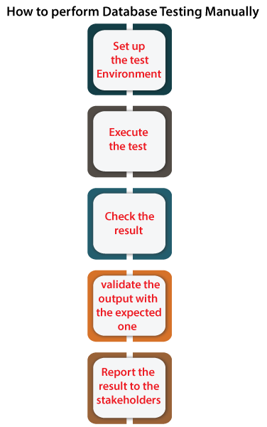
Steps to perform DB testing
Step1: Set up the test environment
Firstly, we need to prepare the test environment to test the software application.
Step2: Execute the test
Once we set up the test environment, we will run particular test case.
Step3: Check the results
When the test case is executed successfully without having any issues, we will check the specified test case results.
Step4: Validate the output with the expected one
After checking the test case result, we will validate the same output with the excepted one. If the results meet the excepted output, the test case will consider as a pass; otherwise, it will be marked as a fail.
Step5: Report the results to the stakeholders
And at last, we will report the results to the stakeholder of the particular software application.
Then, the test will involve running through these queries and checking the data integrity, which means that the resulting data will need to be truthful, accurate, complete, retrievable, and verifiable.

Slide 12
Usually, SQL queries are used to develop the tests. The most commonly used command is “Select”.
Select * from <tablename> where <condition>
Apart from Select, SQL has 3 important types of commands:
DDL: Data definition language
DML: Data manipulation language
DCL: Data control language
Let us see the syntax for the most commonly used statements.
Data Definition language Uses CREATE, ALTER, RENAME, DROP and TRUNCATE to handle tables (and indexes).
Data Manipulation language Includes statements to add, update and delete records.
Data control language: Deals with giving authorization to users for manipulation and access to the data. Grant and Revoke are the two statements used.
Grant syntax: Grant select/update On <table name> To <user id1, user id2…useridn>;
Revoke syntax: Revokeselect/update on <table name> from<user id1, user id2…useridn>;

Slide 13
How automation can help in Database Testing
In software testing, Automation testing is used to decrease the repetitive manual work, which helps the test engineer focus more on critical features, which work the same for the database testing.
Let's see a few scenarios where automation can be very useful for the test engineer:
Modification in the database schema
When every schema is modified, the database needs in-depth testing to ensure that the things are in place. And the number of scenarios to be covered based on the size of the database. And this process is time-consuming if we have done it manually.
Monitoring for data integrity issues
There can be a condition where a set of data gets corrupted in recovery or other actions because of human error or other issues.
But if we consider the automated monitoring processes, it became easier to find those variations, and we can fix them as soon as possible.
New or frequently altering applications
As we know that Agile methodology is the new era of testing, where we will have a new release to production at the end of every sprint, which implies it will take every 2-3 weeks to complete one round of testing.
But with the help of automation features, which is completely constant and unchanged in the recent sprint, we can focus on new modified requirements.

Slide 14
Database testing tools
There are loads of database testing tools out there. The database testing tool you choose will depend on one or more of the following:
Testing strategy (manual, automated or hybrid)
Database type (SQL or No-SQL)
Database vendor (MySQL, MSSQL, Oracle, or other)
Most database testing systems are comprised of more than just one tool. For example, Selenium can be used with TestNG for database testing in Java applications. Similarly, SeLite uses Selenium for testing SQLite databases while SQL server comes bundled with tools for unit testing databases.

